Slide 1

NGO PROJECT
PROPOSAL
BOOTSTRAP
A Global Non-Governmental Organizations

Slide 2
TABLE OF CONTENTS
01
04
About the Project
Sneak Peek
02
05
Major Requirements
Project Stages
03
06
Project Goals
Our Sponsers
Brief Introduction about the Project and the Website.
Brief introduction about the architecture of the project making.
Required Developer content like details Content, Images, Videos etc.
Website Structure Flowchart and implementation Stepwise.
Budget, Fundraising, Volunteers Added and Branding etc.
Fund Provider Sponsors Details and some of the registration rule.

Slide 3



OUR COMPANY
“flexacare” is Non- Governmental Organization i.e. free from the control of the government rules and work for the welfare of the society. They can also be consider as the mediator between the society and the government. Basically they are there in the society as volunteer to help the needy people in every field possible by getting the money from the society itself.

Slide 4



WHAT WE ARE WORKING ON
SECURE
ACCESSIBLE
FAST AND RELIABLE
A secure website has a web application firewall activated to prevent attacks and hacks. It also follows website security best practices and has no configuration issues or known vulnerabilities.
It means that websites, tools, and technologies are designed and developed so that people with disabilities can use them. More specifically, people can: perceive, understand, navigate, and interact with the Web. contribute to the Web.
Fast and Reliable websites are transparent about their sources and help the reader gain a deeper understanding of the topic, rather than relying on opinion pieces or second-hand news.

Slide 5





ABOUT THE PROJECT
Task-oriented and driven by people with a
common interest, NGOs perform a variety of
service and humanitarian functions, bring
citizen concerns to Governments, advocate
and monitor policies and encourage political
participation through provision of information.

Slide 6
HTML + CSS + JAVASCRIPT + BOOTSTRAP
TECHNOLOGY USED

Slide 7



NOW
POOR DESIGN
PROGRAMMING MISTAKES
LACK OF ADAPTABILITY

Slide 8



FUTURE
BRANDING
POSITIONING
ADAPTABILITY

Slide 9
MAJOR REQUIREMENTS
IMAGES
USER EXPERIENCE
INFO UPDATES
After approval of prototypes by the client, graphic designers take the final design step by shifting the design in Photoshop or Illustrator
Implement a visual hierarchy for highlighting the most important elements first and less afterward
Updating websites regularly keeps your website contemporary and boosting the growth of your business and website performance.

Slide 10
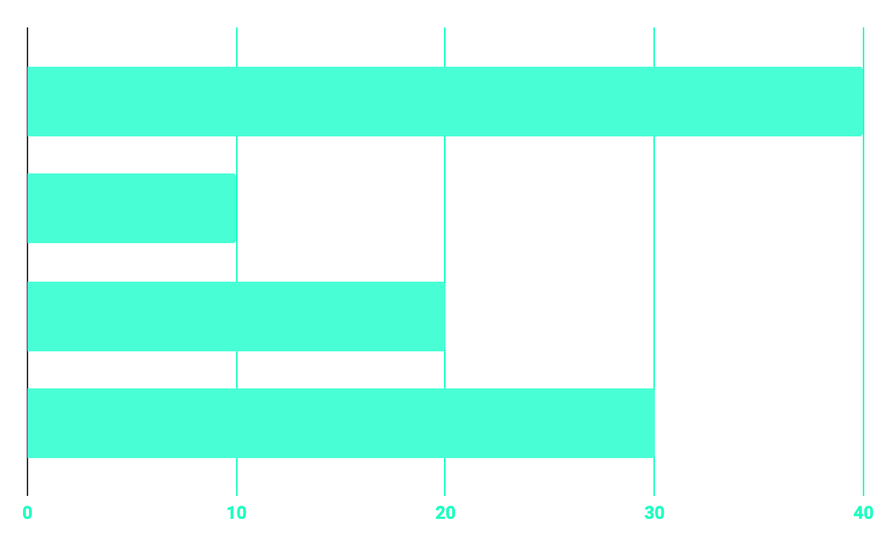
BUDGET
40%
20%
PROGRAMMING
10%
30%
DATABASE
WEB DESIGN
UX RESEARCH

Slide 11



OUR GOALS
EXPANSION
POSITIONING
USABILITY
Branding Strategies are there where Brand Logo, Optimum Word Content, Storytelling Approaches in design, social media like elements must be there
Enable website users to share your reviews on review sites to leverage third-party services which offers coding to highlight your web page ratings
Make website available and accessible by focusing on server uptime, broken links, and mobile responsiveness

Slide 12


PREDICTED RESULTS
CONVERSIONS NEXT YEAR
+20%
MONTHLY VISITS
+33%
CONVERSION RATE
+40%
ANNUAL ORDERS

Slide 13
SNEAK PEEK
HEADER
TEXT
SLIDER
ICONS

Slide 14

A VIDEO IS A GOOD IDEA
Makes the Information Easily Understandable and User Interface Easy.

Slide 15
PROJECT STAGES
STEP 2
STEP 1
STEP 3
“Implementation“ Developer must have complete list of required content and begin with the design development. Then presents the sample designs for review.
“Planning” Project Definition Meeting with you to determine precise details concerning the scope of the project and develop an accurate and detailed timeline outlining the development and delivery of the project, including deliverables for the developer
Developer will test all aspects of the project, including Quality Assurance testing for functionality, spelling and grammatical errors, consistency of graphics, and technical specifications.

Slide 16
OUR TIMELINE
WEEK 1
WEEK 3
BETA
RELEASE
FINAL
VERSION
WEEK 2
WEEK 4
Improvements
Increased traffic
Focus group
Progress Fund review

Slide 17



OUR PARTNERS
People get tax benefit when they donate to such Ngo’s which have 80g, 35ac.
The donor gets 50% tax rebate from its tax while donating to an Ngo which has 80g registration.
The donor gets 100% tax rebate from its tax while donating to an Ngo which has 35ac registration.

Slide 18

THANKS!
addyouremail@freepik.com
Anant Saini
1726087

